Slide 1
Towards Convergence of AI and IoT for Energy Efficient Communication in Smart Homes
Jannatul Ferdous Eva (18201053)
Saqib Sizan Khan (18201061)
Ayman hasib (18201065)

Slide 2
Introduction
This research is about smart healthcare system by the combination of AI and IOT. In this research mainly focuses how to communicate more energy efficiently between the IOT devices and service center.
Quality of Service (QoS) optimization during video streaming through wireless micro medical devices (WMMD) in smart healthcare homes is the main purpose of this research.
This research based on four distinct ways:
Lazy Video Transmission Algorithm (LVTA)
Video Transmission Rate Control Algorithm (VTRCA)
A novel cloud-based video transmission framework
The relationship between buffer size and performance indicators (PMR)

Slide 3
Paper Section
Section 1: Research Foundation
Section 2: Related Works
Section 3: Video Transmission Algorithm for Wireless Micro-Medical Devices
Section 4: Encoding & Transmission Energy Consumption During Video Streaming
Section 5: Experimental Results & Discussion
Section 6: Conclusion

Slide 4

01
Research Foundation
This research focuses on cloud-based deployment, QoS optimization while transmitting video through WMMDs.
From the point of view of figure 1, this technology consist of a media streaming server (stores pre-recorded encoded VBR video of Medical-education for elderly people and infants), video sensor nodes, base station(BS), gateway video sensor, sender, receiver. It is a simple star network topology network. The media streaming server provides content and transmits at the rate of 30 fps to video sensor nodes on human body. WMMD on human body capture the pre-recorded video from media streaming server through built-in cameras and forward that video to the BS. Then the content is decoded and then transferred to the gateway video sensor node. Finally, the decoded video is distributed through internet which is connected with the hospital monitoring network and intended receiver.

Slide 5
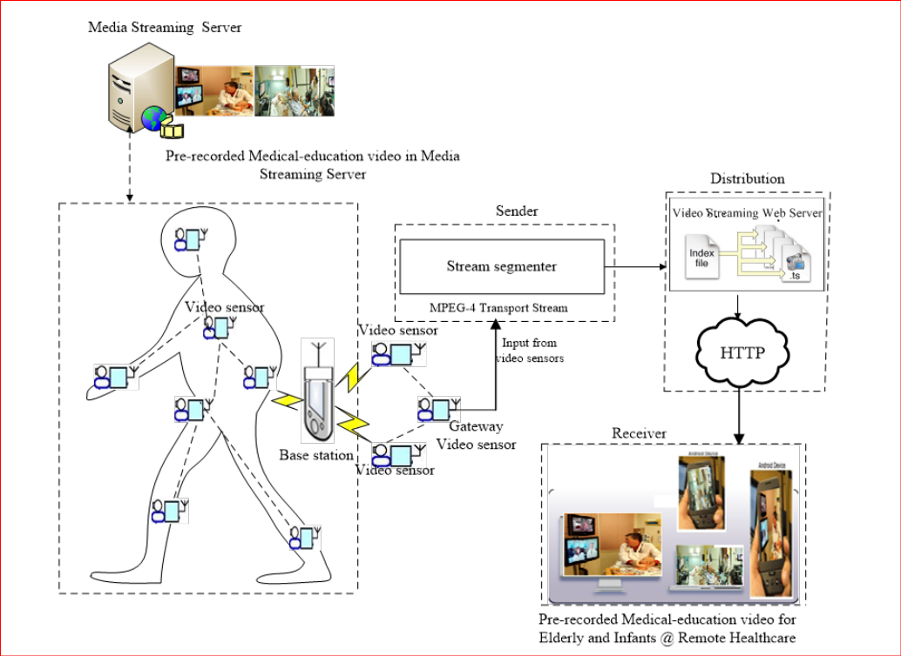
Figure 01: Cloud-based framework of efficient video transmission through wireless micro medical devices

Slide 6
Section 02 (Related Works)
In other related works with this paper, authors discussed about the following topics:
Emerging networks
Network transmission power
Network energy optimization
Communication strategies, techniques, frameworks
Deliver voluminous multi-media content at remote location
Networking sensor-based healthcare system
Among all those types of networking works none of them are focused on QoS (Quality of Service) during multimedia transmission and it is not highlighted in any other paper. So in this paper authors are focusing on the QoS in video transmission network.

Slide 7
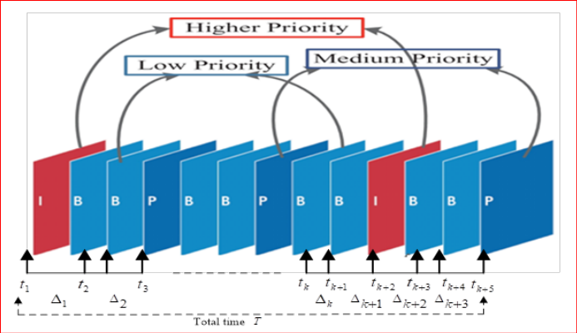
Section 03 (Video Transmission Algorithm)
In this paper authors proposed algorithm which have three types of frames (a) inter-coded [I], (b) bi-directional [B], (c) Previous [P]. Among all these frames, I-frame is the most priority frame for its exceptional role during operation. After that P-frame is the mid level and B-frame is the lowest priority in this communication show as figure 2.
Here, each of the frame is dealing with time slot (t), also ∆ and T show the time between frames in the entire video transmission. There also two nodes (1) receiver, (2) transmitter.
Figure: 02

Slide 8
Section-04 (Encoding & Transmission Energy Consumption)
For enhancing the transmission energy consumption during video streaming authors used the following equations to get the BASELINE result to compare with other algorithms LVTA and VTRCA
Penc = k × C × V 2 × f
f ∝ (V − Vth) γ /V
Eenc = Penc × tenc = V × I × tenc
Eencavg = IC × CPI × Eenc /V F
Etx = V × I × ttx

Slide 9
Section 05 (Experimental Result & Discussion)
From their experiment they get the following result, and they visualize their result by the graph.
In figure 3(a), 3(b) it shows the relation between QoS metrics such as Std.dev, PMR and Time. Figure 3(c) shows the relationships between Delay and Buffer Size to analyze the QoS performance of Baseline, LVTA and VTRCA.
In figure 4(a) it indicate the connection among Fram Index and PSNR. In figure 4(b) shows relation between Charge Optimization & Sensor Nodes for measuring battery capacity. In figure 4(c) represents the connection between Modulation Level & Total Energy Drain.

Slide 10
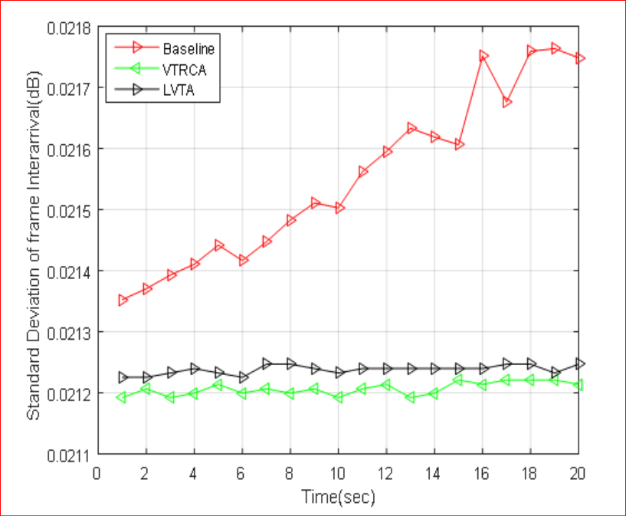
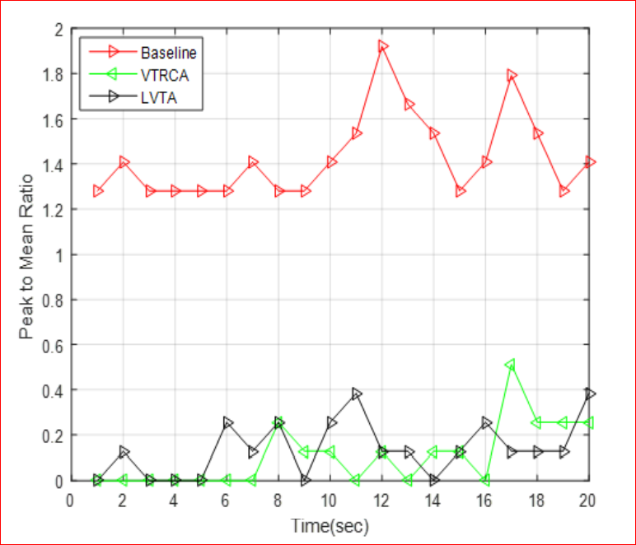
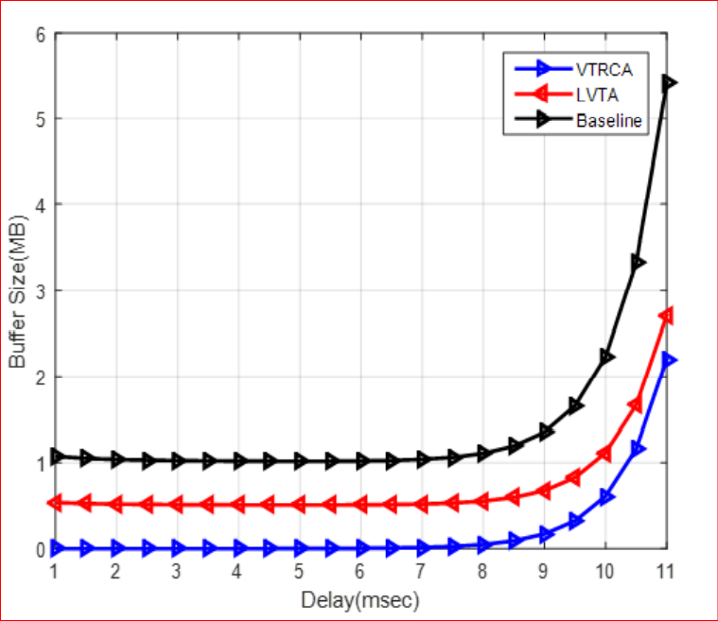
Fig: 3(a) Std.dev vs Time
Fig: 3(b) PMR vs Time
Fig: 3(c) Buffer Size vs Delay

Slide 11
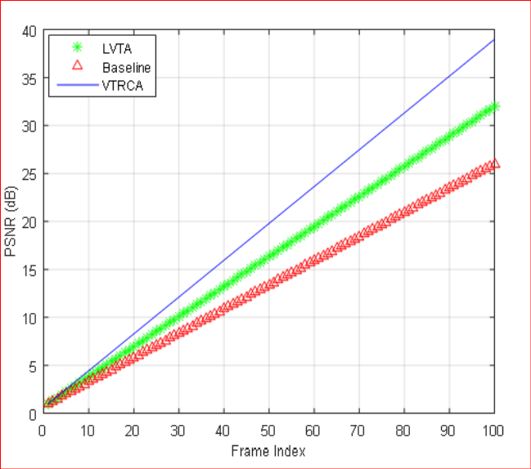
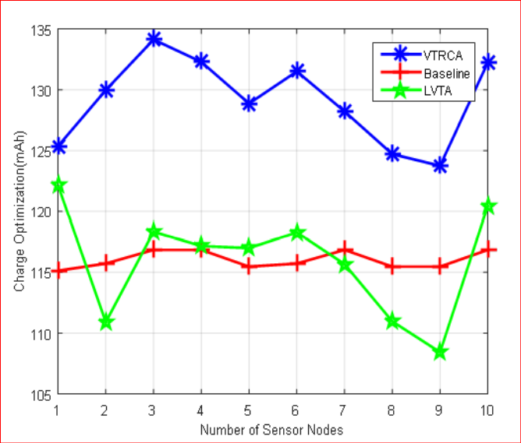
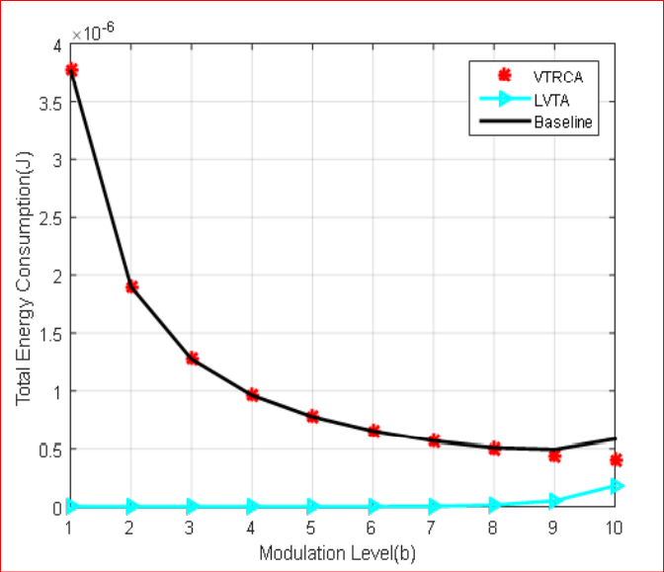
Fig: 4(a) Frame Index vs PSNR
Fig: 4(b) Sensor Node vs Charge Drain
Fig: 4(c) Modulation Level vs Total Energy Drain

Slide 12
Section 06 (Conclusion)
VTRCA and LVTA both algorithms adjust the high peak rate video frames by adopting the required buffer size. But it is clear that VTRCA performs better than LVTA and Baseline by saving more transmission energies while minimizing PMR and Std.dev. Though it performs better but there are also have some drawbacks.
So in near future the authors will focus on the Quality of Experience (QoE) in the perspective of medical and health sector with IoT system domain.

Slide 13
Advantages
Limitations
Authors highlighted QoS during multimedia streaming.
Improve Medical healthcare
Transfer data in remote locations
Handles the emergency situation
Energy optimization
Helpful for elderly and infants
Central server failure
Sensor node failure
To many devices to control

Slide 14
Thanks!
Everyone
Do you have any questions?

